Slide 1
Computer Security Principles
COMP6824001
Protocol Network Security
Session 9

Slide 2
These slides have been adapted from:
Panek, Crystal. (2019). Security Fundamental, John Wiley & Sons, Inc. Indianapolis. ISBN: 978-1-119-65066-9
Lesson 4
Acknowledgement

Slide 3
- Understanding DNS & DNS Security Extentions
- Protocol Spoofing
- Network Sniffing
- Common Attack Methods
- DoS & DDoS Attack
- IPV4 vs IPV6
- Network specific threats and attack types
- Defense mechanisms and countermeasures
Subtopics

Slide 4
Understanding DNS &
DNS Security Extentions
The DNS is a service used on the Internet for resolving fully qualified domain names (FQDN) to their actual Internet Protocol (IP) addresses, using a distributed network of name servers.
DNS Security Extensions (DNSSEC) adds security provisions to DNS so that computers can verify that they have been directed to proper servers.
DNSSEC provides authentication and integrity checking on DNS lookups, ensuring that outgoing Internet traffic is always sent to the correct server.
DNSSEC provides authentication and integrity checking through the use of public key encryption.
Notes:
The domain name structure provides a hierarchy of authenticated keys, creating
a chain of trust from the root of the DNS hierarchy to the domain being queried.
DNSSEC will address many of the most problematic security issues associated with the
Internet’s core infrastructure, but it comes at a significant cost. As with any large-scaled
public key implementation, rolling this out to the entire Internet will be an enormously
complex, resource-intensive project. There are also challenges associated with maintaining
the web of trust created by using public keys on such a large scale.

Slide 5
Understanding Protocol Spoofing
Protocol spoofing is the misuse of a network protocol to perpetrate a hoax on a host or a network device. Some common forms of protocol spoofing include:
ARP spoofing
DNS spoofing
IP address spoofing
Notes:
ARP spoofing ARP (Address Resolution Protocol) spoofing (or ARP poisoning) is an
attack on the protocol used to determine a device’s hardware address (MAC address) on the
network when the IP address is known. This is critical for the proper delivery of network
data once the data has reached the proper LAN segment. An ARP spoofing attack occurs
when an attacker modifies the network’s ARP caches and takes over the IP address of the
victim host. This permits the attacker to receive any data intended for the original host.
DNS spoofing DNS spoofing occurs when an attacker is able to intercept a DNS request
and respond to the request before the DNS server is able to. As a result, the victim host is
directed to the wrong website, where additional malicious activities can take place. This
attack is frequently used in conjunction with network sniffing, which will be discussed in
the next section.
IP address spoofing In an IP address spoofing attack, the attacker creates IP packets
with a forged source IP address either to conceal the identity of the attacking host or to
impersonate the identity of a victim host. This attack was very popular in the early days of
packet analysis firewalls—an attacker would spoof an internal IP address from the outside
of a firewall, and if not configured correctly, the firewall would permit access to the internal
network.

Slide 6
Understanding When to Use a Hardware Firewall Instead of a Software Firewall
Host Firewall
Network Firewall
One type of software firewall is a firewall application installed on a host, used to protect the host from network-based attacks
Host firewalls are also known as personal firewalls.
The other type of software firewall is a firewall application installed on a server used to protect network segments from other network segments
The most popular network firewalls are those produced by Cisco

Slide 7
Understanding Network Sniffing
Network sniffing is a type of network analysis that is a very useful tool for network administrators responsible for maintaining networks and identifying network issues.
Wireshark, reveals a significant amount of information about the packet being analyzed. To a network administrator with an in-depth understanding of networking, this information can be used to identify application issues, network latency, and a variety of other network errors.
Attacker with similar skills, the information offered by network sniffing provides equally valuable information that can be used for attacking a network.

Slide 8
Understanding Denial-of-Service
(DoS) Attacks
A denial-of-service (DoS) attack is an attack whereby the attacker renders a machine or network resource unavailable. It is usually done by flooding the targeted machine or resources with superfluous requests in an attempt to overload the system.
When a DoS attack occurs, the usual symptoms include the following:
  Unusually slow network performance, including when opening files or accessing websites
  Unavailability of any or all websites
  Dramatic increase in the number of spam emails received
There are three general types of DDoS attacks:
  Volume-Based Attacks
  Protocol Attacks
  Application-Layer Attacks

Slide 9
Understanding Denial-of-Service
(DoS) Attacks
Popular and dangerous types of DDoS attacks include:
  UDP flood
  ICMP (ping) flood
  SYN flood
  Ping of death
  HTTP flood
  Email bomb
  Zero-day attacks

Slide 10
IPV4 vs IPV6 Security
An IP stands for internet protocol, which assigned to each device connected to a network.
Each device uses an IP address for communication, also behaves as an identifier as this address is used to identify the device on a network.
Types of IP addresses:
  IPv4, the most commonly used IP address.
  IPv6, is the next generation of IP addresses
Notes:
Source: https://www.javatpoint.com/ipv4-vs-ipv6

Slide 11
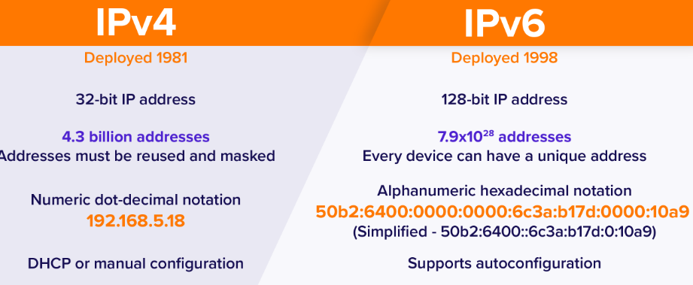
IPV4 vs IPV6 Security
https://www.avast.com/c-ipv4-vs-ipv6-addresses
Notes:
https://www.avast.com/c-ipv4-vs-ipv6-addresses

Slide 12
IPv4 AND IPv6 SECURITY
IPsec is a group of protocols that are used together to set up encrypted connections between devices.
Users have some security concerns that cut across protocol layers
For example,an enterprise can run a secure, private TCP/IP network by disallowing links to untrusted sites,encrypting packets that leave the premises, and authenticating packets that enter the premises.By implementing security at the IP level, an organization can ensure secure networking not onlyfor applications that have security mechanisms but also for the many security-ignorantapplications.
IP-level security encompasses three functional areas:
  Authentication
  Confidentiality
  Keymanagement
Notes:
The authentication mechanism assures that a received packet was, in fact,transmitted by the party identified as the source in the packet header. In addition, this mechanismassures that the packet has not been altered in transit. The confidentiality facility enablescommunicating nodes to encrypt messages to prevent eavesdropping by third parties. The key management facility is concerned with the secure exchange of keys. The current version of IPsec,known as IPsecv3, encompasses authentication and confidentiality. Key management is providedby the Internet Key Exchange standard, IKEv2.
Sc: https://www.cloudflare.com/learning/network-layer/what-is-ipsec/

Slide 13
Applications of IPSec
Secure branch office connectivity over the Internet: A company can build a secure virtual private network over the Internet or over a public WAN. This enables a business to relyheavily on the Internet and reduce its need for private networks, saving costs and networkmanagement overhead.
Secure remote access over the Internet: An end user whose system is equipped with IPsecurity protocols can make a local call to an Internet service provider and gain secure accessto a company network. This reduces the cost of toll charges for traveling employees andtelecommuters.
Establishing extranet and intranet connectivity with partners: IPsec can be used tosecure communication with other organizations, ensuring authentication and confidentiality andproviding a key exchange mechanism.
Enhancing electronic commerce security: Even though some Web and electroniccommerce applications have built-in security protocols, the use of IPsec enhances thatsecurity.
Notes:
IPsec provides the capability to secure communications across a LAN, across private and publicWANs, and across the Internet

Slide 14
Network specific threats and attack types
The types of attacks that can be expected when working to protect computer networks, includes following:
  Denial-of-Service/Distributed Denial-of-Service (DoS/DDoS) Attacks
  IP Spoofing to Bypass Network Security
  Man-in-the-middle attacks
  Back door attack
  DNS poisoning
  Replay attack
  Weak Encryption Keys
  Social engineering
  Password Cracking
  Dictionary Attack
  Brute Force Attack
  Software Vulnerability Attack
  Buffer overflow attack
  Remote code execution attack
  SQL injection attack
  Cross-site scripting (XSS) attack

Slide 15
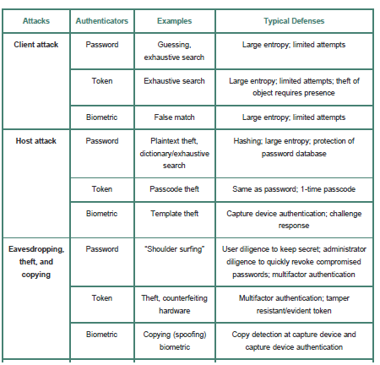
Defense Mechanisms and Countermeasures
Stalling, William, 3.6 security issues and defense mechanism

Slide 16
References
Panek, Crystal. (2019). Security Fundamental, John Wiley & Sons, Inc. Indianapolis. ISBN: 978-1-119-65066-9
Stallings, William and Lawrie Brown. 2018. Computer Security: Principles and Practice, 4th Edition. Global Edition, Pearson Education Limited
https://www.javatpoint.com/ipv4-vs-ipv6
https://www.avast.com/c-ipv4-vs-ipv6-addresses

